Slide 1
Bay Creek Neighborhood Assets & Needs Assessment
December 2018

Slide 2
Methods
Census data
Household survey
Business Interviews
Youth Interviews

Slide 3
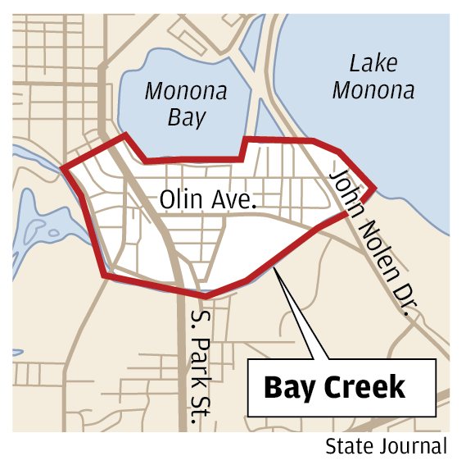
Research Questions
How is the Bay Creek neighborhood changing over time?
How does the neighborhood compare to other neighborhoods?

Slide 4
Age Demographic Characteristics of Bay Creek
The neighborhood of Bay Creek has gotten younger.
In 2016, the percentage of residents under the age of 19 was 15.7%, nearly identical to what it was in 2000. Bay Creek (CT.13) is younger than it used to be, but older than its neighboring tracts.
2011 →
2016
2000 →
Census Tract |  | 13 | 14.01 | 14.02 | Madison
Total Population |  | 2,572 | 5,341 | 6,382 | 208,054
Median Age |  | 39.6
% over 65 |  | 11%
% under 19 |  | 15.5%
Census Tract |  | 13 | 14.01 | 14.02 | Madison
Total Population |  | 2,330 | 5,505 | 5,543 | 231,783
Median Age |  | 41.1 | 29.8
% over 65 |  | 11% | 8.73%
% under 19 |  | 14.5% | 26%
Census Tract |  | 13 | 14.01 | 14.02 | Madison
Total Population |  | 2,479 | 6,867 | 5,376 | 246,034
Median Age |  | 38.6 | 28 | 29
% over 65 |  | 9.3% | 5% | 7%
% under 19 |  | 15.7% | 32% | 28.7%
Notes:
Elizabeth needs to write stuff about this to 1990

Slide 5
Racial Composition of Bay Creek
Racial Composition stable:
  Race of population in 2016
    80% white,
    6% African American
  Race of population in 2000
    88% white,
    5% African American
*Absence of Hispanic Population data from 2000-2016 Census*

Slide 6
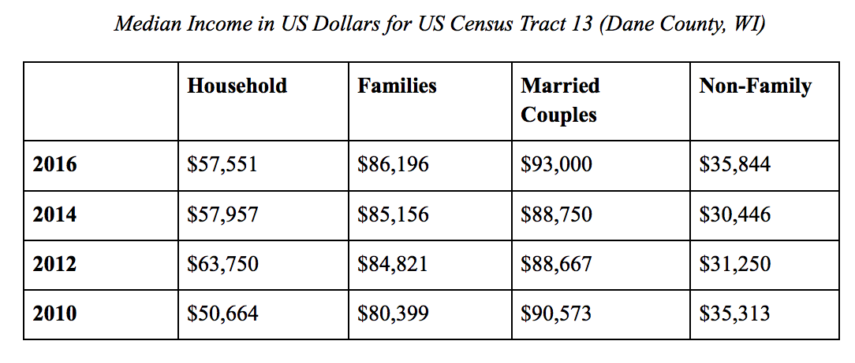
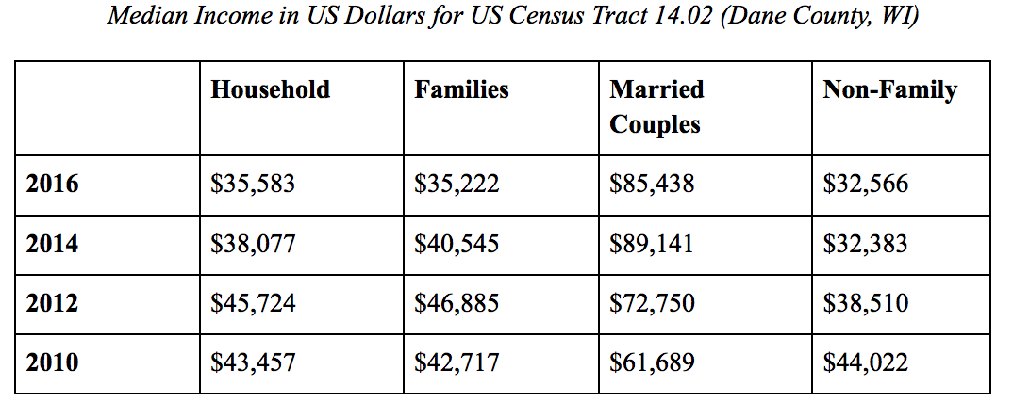
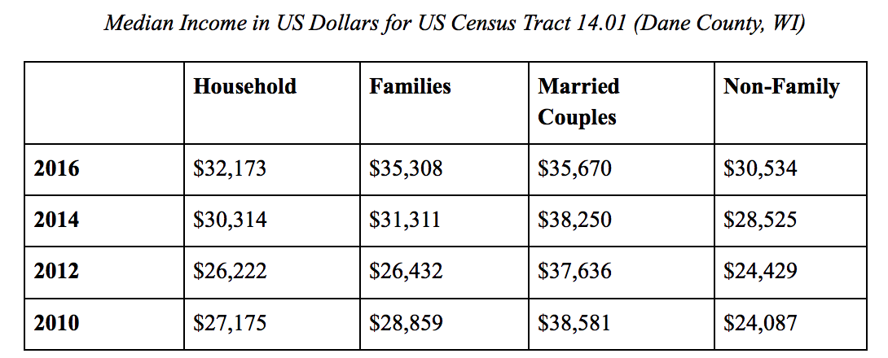
3. Financial Characteristics of Bay Creek: Median Income

Slide 7
Median Income in Bay Creek
Bay Creek is more ‘wealthy’ than its neighbors
  Median income for Bay Creek is $57,551
  Median income for Burr Oaks is $32,173
The Bay Creek neighborhood has also become more affluent since 1990.
  Median income in 1990 $69,000
  Median income in 2016 $86,196
* All data adjusted for 2016 inflation rates

Slide 8
Conclusions
Stability in racial composition
Stability in population size
Become more affluent
  Increase in median income
  Increase in housing values

Slide 9
HOUSEHOLD SURVEY

Slide 10

Satisfaction and Importance of Community Resources
 | % Satisfied | % Extremely or Very Important
Employment | 27 | 46
Education | 57 | 68
Shopping | 33 | 38
Groceries | 52 | 93
Restaurants | 63 | 62
Green space | 81 | 90
Healthcare | 81 | 73
Public transportation | 63 | 75
Options for worship | 26 | 19
Adult outdoor recreation | 80 | 70
Adult indoor recreation | 14 | 38
Youth outdoor recreation | 44 | 58
Youth indoor recreation | 8 | 44
Pedestrian access | 73 | 93
Notes:
Highest level of satisfaction with green space, health care and adult outdoor recreation.
Lowest level of satisfaction with youth and adult indoor recreation.
Highest importance are grocery shopping and pedestrian access.
Least importance are general shopping and adult outdoor recreation.
Biggest gaps are with indoor recreation and grocery shopping.

Slide 11
Rating of Neighborhood’s Infrastructure
 | Very Poor | Poor | Fair | Good | Excellent
Sidewalks | 0.0 | 5.6 | 22.2 | 62.5 | 9.7
Walking/Bike Paths | 1.4 | 1.4 | 12.3 | 56.2 | 28.8
Local Parks | 2.7 | 1.4 | 6.8 | 65.8 | 23.3
Roads (driving) | 1.4 | 9.7 | 34.7 | 47.2 | 6.9
Roads (Biking) | 1.4 | 9.6 | 32.9 | 43.8 | 12.3
Street Parking | 2.8 | 7.0 | 28.2 | 57.7 | 4.2
Connectivity to different parts of the neighborhood | 4.2 | 5.6 | 26.4 | 58.3 | 5.6
Notes:
Parks received best rating.
A few items received lower ratings—sidewalks and walking/bike baths.

Slide 12
Is the neighborhood easy to walk?
Notes:
Most often mentioned difficulty was on or near Park Street and Fish Hatchery Road.

Slide 13
Is the neighborhood easy to bike?

Slide 14
Is the South Park St. Corridor easy to bike?
Notes:
About 70% report that it was difficult to bike on South Park Street Corridor.

Slide 15
Satisfaction with public transportation
Notes:
>75% of residents satisfied with public transportation options. 1/3 never use it. Major reason for not using public transportation is the infrequent schedule.

Slide 16
Use of public transportation

Slide 17
Support more business development in the neighborhood
Notes:
¾ residents support additional business development in the neighborhood. Strong preference for locally-owned shops. In terms of location, several people mentioned the need for more development away from Park Street.

Slide 18
Satisfaction with range of businesses along South Park Street
Notes:
Pretty evenly split with regard to satisfaction with range of businesses on Park Street. Many comments about the need for something other than bars and restaurants.

Slide 19
How often do you shop along South Park Street

Slide 20
Most important issue in choosing a grocery store
Notes:
Quality and location are key factors in decision about where to shop for groceries. Most residents want to see more grocery options in the area, but some concerned with more expensive options.

Slide 21
Support higher density development in the South Park Street Corridor
Notes:
Significant discussion among Madison neighborhoods with respect to higher density development. The neighborhood is largely split. Most people who were uncertain were concerned with the loss of green space, parking/traffic, and height requirements. Strong consensus that new development should maintain “neighborhood feel.”

Slide 22
Enough resident input into development process in the neighborhood
Notes:
Some concern with the development process in Madison.

Slide 23
Should a neighborhood plan be updated?
Notes:
Large number of residents unsure about the need for an updated neighborhood plan.

Slide 24
Support for a community center in the neighborhood
Notes:
Strong support for an additional community center in the area, especially for youth.

Slide 25
Support historic preservation on West Lakeside Street

Slide 26
Concern with affordable housing in the neighborhood
Notes:
Majority have some concern with affordability. As you might expect, renters expressed more concern than homeowners.

Slide 27
Importance of maintaining quality of Olin-Turnville Park

Slide 28
Satisfaction with neighborhood associations activities

Slide 29
Attendance at neighborhood association meetings

Slide 30
Have Madison police been responsive?

Slide 31
Top concerns identified by residents
Walkability/Dangerous crossings
Traffic
Gentrification
Park Street development
Grocery store
Greenspace
Communication
Preservation of historic structures

Slide 32
BUSINESS INTERVIEWS

Slide 33
Business Interviews: Process
Reached out to a variety of businesses in the Bay Creek neighborhood
Conducted one-on-one interviews with five different businesses
Two done via phone, three done in person
Analyzed data by coding major themes

Slide 34
Theme One: Community
Friendly community
Supportive of small businesses
Familiar faces
Enjoy having businesses in the Bay Creek neighborhood
Many businesses see themselves as small businesses providing a need and/or service for their community

Slide 35
Theme Two: Development
Development can help bring more traffic and visibility
Concerns of increased rent and property value (mention of gentrification)
Heartland Housing Project
  Concerns of safety
  Many mentioned the need for appropriate management
  One business was strongly opposed
  Two had concerns
  One business was in support of the project
  One did not know what the project was

Slide 36
Theme Three: Accessibility
Very accessible to foot traffic
Parking
  Those without parking lots wanted more parking meters and 15 minute parking stalls
One business mentioned that snow needed to be plowed during the winter
One business mentioned that traffic from school can make the business inaccessible

Slide 37
Suggestions:
Development to an extent; healthy balance of income levels
Display of neighborhood information and history (suggested help from the University)
Repurpose old buildings instead of tearing them down
Ways for the community to provide input or suggestions on how businesses can better meet their needs
Heartland should work on improving their current locations before expanding to Bay Creek
City provide rules and regulations for the Heartland project to ensure safety
Better lighting on Lakeside Street
Map showing businesses

Slide 38
YOUTH INTERVIEWS

Slide 39
Bay Creek Youth
Involvement
Sports
School Dances
Few (no) Community Events
Mobility
Car to school
Bus to B&G Club
Van Home
Interests/Recreation
Sports
Online games
Eat at chain restaurants
Shop at Walmart
Dance, Music and Art
Puzzles
Desires
More Recreation Groups
Community Center
Safer Environment
More Parks
Notes:
Bay Creek Document:
Overlap with desire for improved traffic safety
Overlap with strategic objective to “enhance the neighborhood’s environmental and recreational resources” and “improve traffic conditions” (40)
Recommendations for Action Section (41):
Hold annual neighborhood festival and encourage coordinated linkage between Bay Creek Neighborhood and adjacent neighborhoods → Based on the kids responses, this could be something to focus on since some children mentioned how they could not see their friends after school or on the weekends because they don’t live by them. So coordinating a way for kids to spend more time with each other outside of school could be beneficial.
“The Neighborhood Association should contact the City Parks Department about using a couple of vacant lots for playlots” (46) → many of the kids loved playing outside; they also wanted more places to play inside during the winter months (which is where the community center, or some other recreation center could come in)
Increase lighting and maintenance of parks → some kids said they didn’t live near a park and therefore didn’t have a favorite, or it was just the Boys and Girls Club park
Mobility: mixed responses about street safety, but this could have had to do with the fact that they are not all from the same area

Slide 40
Broad Themes
Strong desire to maintain “neighborhood” feel in the area.
Concern over loss of grocery shopping options and proposed development on Park Street.
Housing affordability, especially among renters
Support for youth (and adult) recreation facilities.
Support for business development—but concerns with high density development.

Slide 41
Next Steps??

